Slide 1
TEXTILE DESIGN

Slide 2
WHAT IS TEXTILE?
The word textile is from Latin which means "to weave", "to braid" or "to construct“.

Slide 3
PRE HISTORIC DEVELOPMENT
Modern humans are the only survivors of several species of naked apes who may have worn clothes, according to DNA studies of clothing lice. This study suggests that clothing may possibly have been used 650 thousand years ago –. First fabric uses, likely to be felt, are thought to have been used about 100,000 years ago.

Slide 4
HISTORY OF CLOTHING AND TEXTILE
The persistence of ancient textile arts and functions, and their elaboration for decorative effect, can be seen in a Neolithic Age.
Textiles also appeared in the Neolithic Age. Since cloth could be woven from wool or flax, clothing became more plentiful and there was much less trust on the skins of animals
The wearing of clothing is exclusively a human characteristic and is a feature of most human societies.

Slide 6
Processes
Most textile arts begin with twisting or spinning and plying fibers to make yarn (called thread when it is very fine rope when it is very heavy).
The yarn is then knotted, knitted, looped, braided, or woven to make flexible fabric or cloth, and cloth can be used to make clothing and soft furnishings.

Slide 7
PROCESSES
1. SPINNING AND PLYING
2. KNOTTING
3. KNITTING
4. LOOPING
5. BRAIDING
6. WEAVING
7. CLOTHING
8. EMBELLISHMENT/ SURFACE DECORATION

Slide 8
SPINNING
Spinning is a major part of the textile industry. It is part of the textile manufacturing process where three of fibers are converted into yarn, then fabrics, which undergo finishing processes such as bleaching to become textiles.

Slide 10
PLYING
Plying is done by pulling yarn from two or more reels and twisting it together, from that in which it was spun.
Depending on the weight desired, the yarn may or may not be plied.

Slide 11
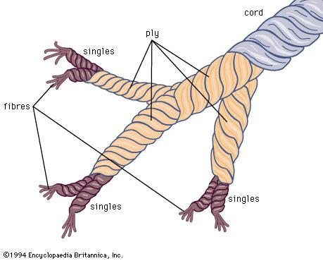
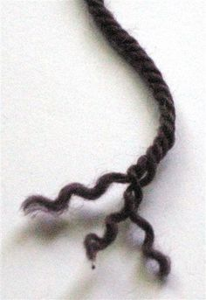

Slide 12
KNOTTING
The action or craft of tying knots in yarn to make carpets or other decorative items.
The knots tied in a carpet or other item.
Also used in making nets.

Slide 13
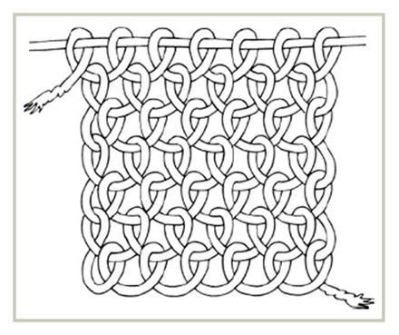
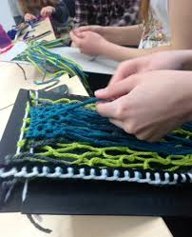

Slide 14
KNITTING
Knitting is a method by which thread or yarn is used to create a cloth.
Knitted fabric consists of a number of consecutive rows of loops, called stitches.
Knitting may be done by hand or by machine. There exist numerous styles and methods of hand knitting.

Slide 15
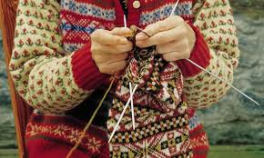
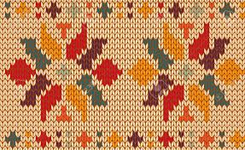

Slide 17
WEAVING
Weaving – the cloth is prepared on a loom, of which there are a number of types. Some weaving is still done by hand, but the vast majority is mechanized.

Slide 18
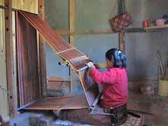

Slide 19
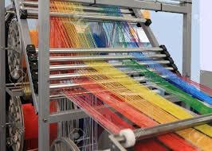
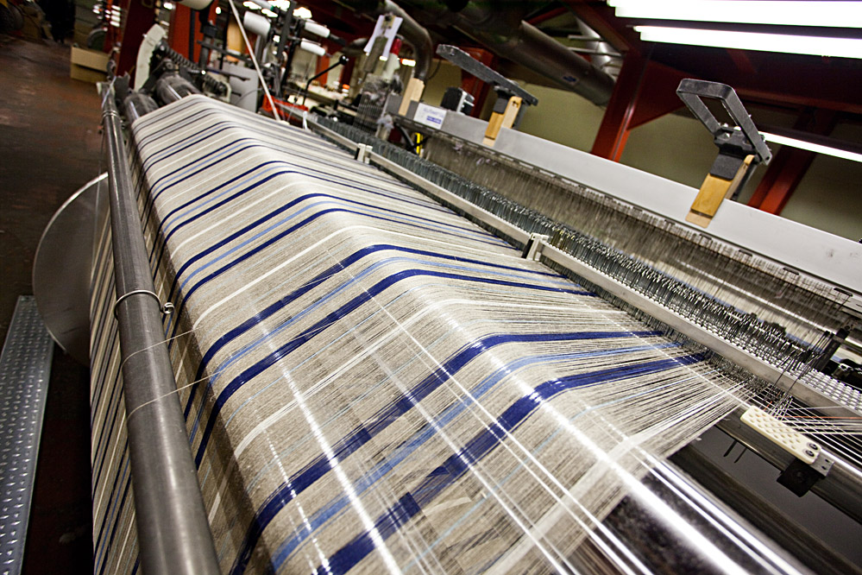

Slide 21
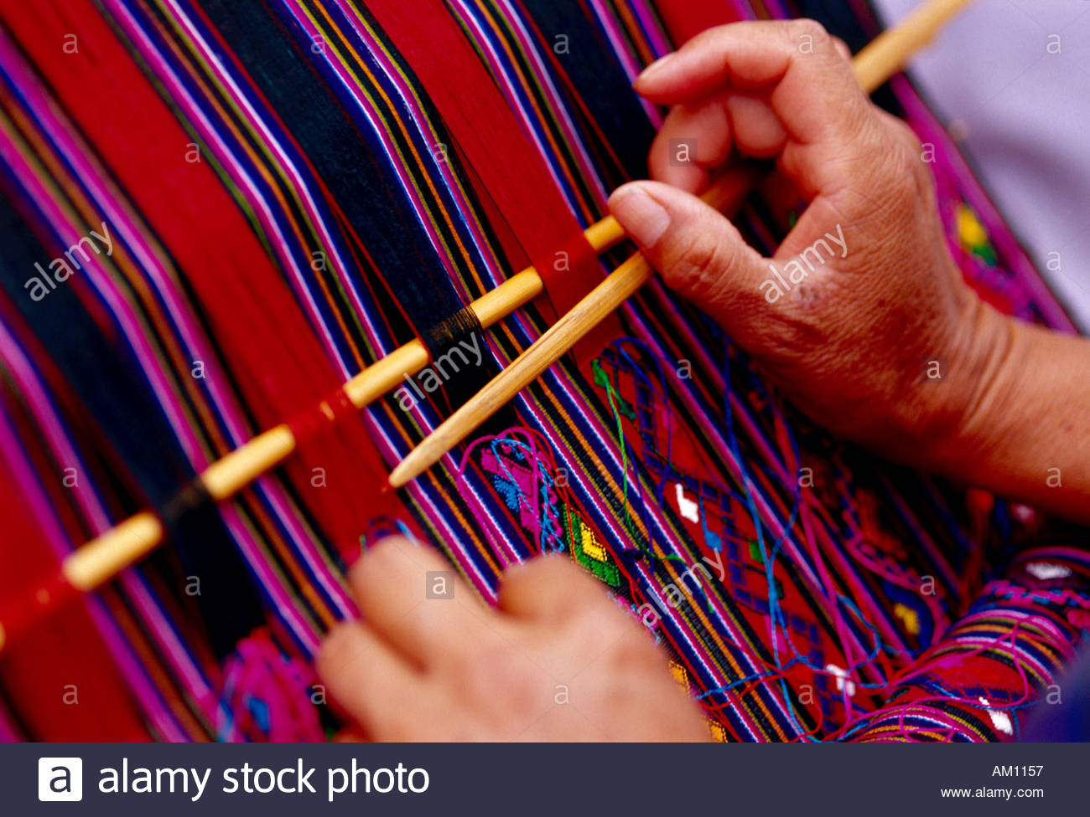

Slide 22
TECHNIQUES OF EMBELLISHMENT/ SURFACE DESIGN
Surface design techniques can be used to create unique, original fabrics for your textile art or designs.
Common techniques include fabric dyeing, painting, and printing, as well as digital image transfer. There are many different approaches within each of these categories: screen printing, dyeing, stamping, and more.

Slide 23
1. DYE
Color that chemically bonds with the fibers is called “DYE”.
Dyeing – adding color to textiles: there is a vast range of dyes, natural and synthetic, some of which require penetrating.
In dying there are two main types:
1. TIE & DYE
2. BANDHANI

Slide 24
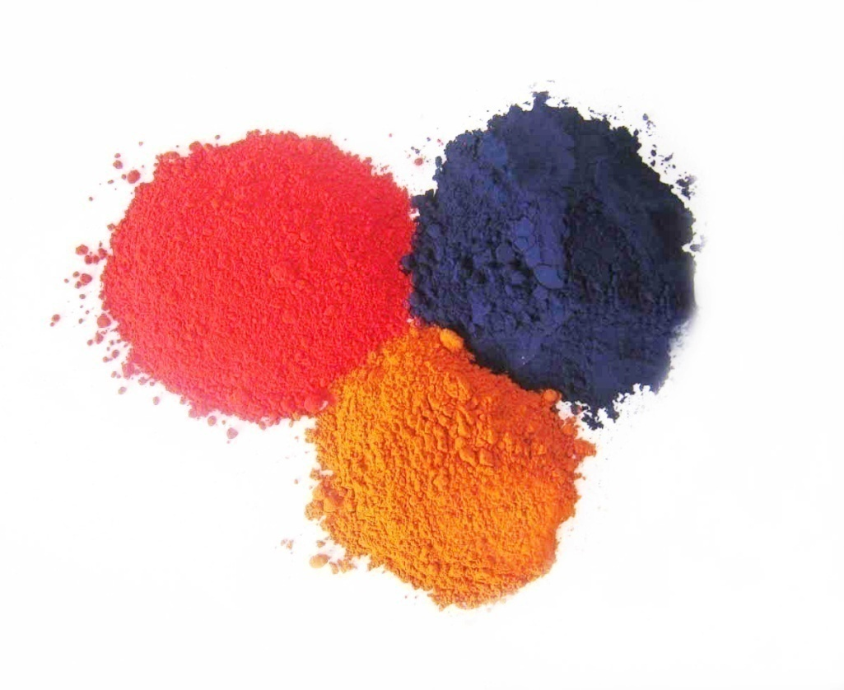

Slide 25
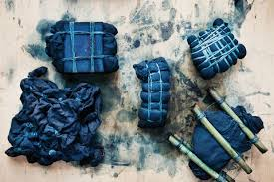
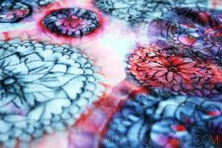

Slide 26
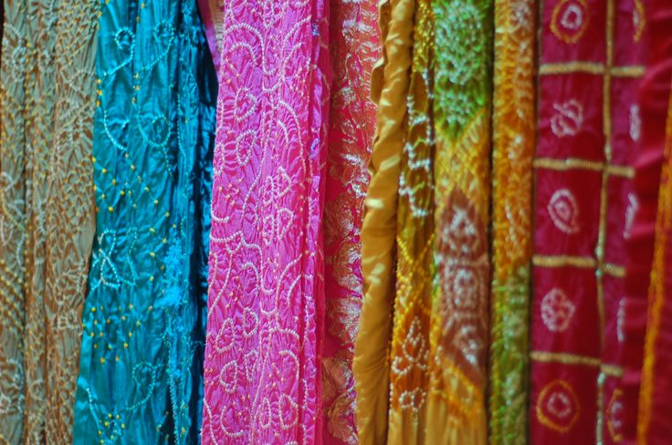

Slide 27
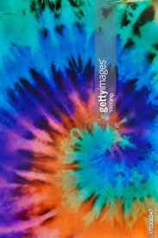

Slide 28
2. PRINTING
Application of a color with help of blocks, stamps or stencils to the surface of a cloth to create a repeatable design by means of a prepared surface which is pressed against the cloth.
There are two common methods of Hand Printing:
1. BLOCK PRINTING
2. SILK SCREEN

Slide 31
3. BATIK
The application of waxes, pastes, or similar material as a resist (oppose) in order to created a dyed design.
http://www.expat.or.id/info/batik.html

Slide 32
4. FABRIC PAINTING
Painting: Application of a color to the surface of a cloth in a non-repetitious manner by means of a brush, sponges, or other instrument.

Slide 33
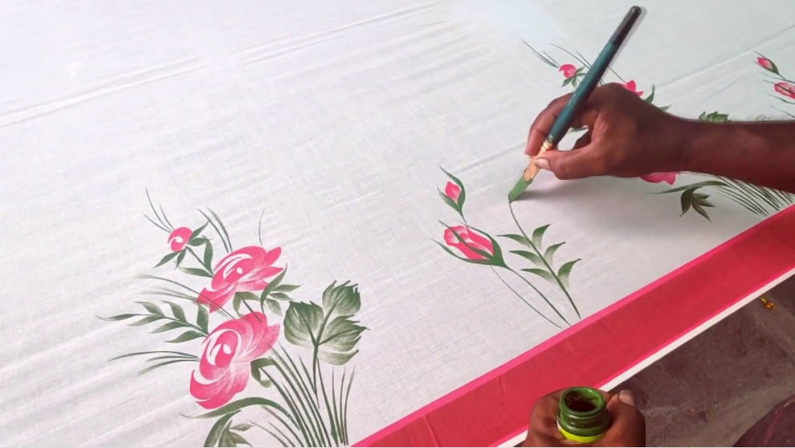

Slide 34
TECHNIQUES THAT USE A NEEDLE AND THREAD
1. EMBROIDERY
2. APPLIQUE or PATCH WORK
4. QUILTING
5. CROCHET

Slide 35
EMBROIDERY
The decorative application of threads to the surface of a textile by means of a needle.
OR
Threads which are added to the surface of a finished textile for ornamentation.
There are different types of Hand and Machine embroideries.

Slide 37
APPLIQUE or PATCH WORK
The technique of stitching cut shapes of fabric onto a background fabric.
Pieces of fabric, usually in different colors and patterns, assembled to create a larger panel or embellished a fabric in a different traditional manner.

Slide 39
QUILTING
Stitching which holds layers of fabric and (usually) an inner layer of padding together.

Slide 40
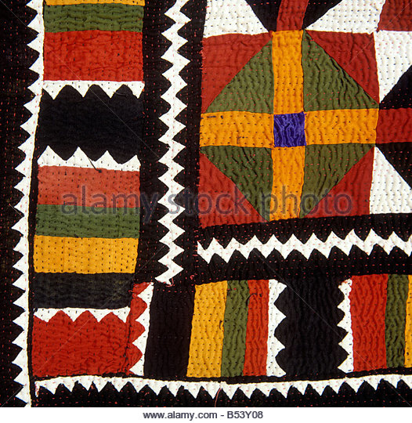
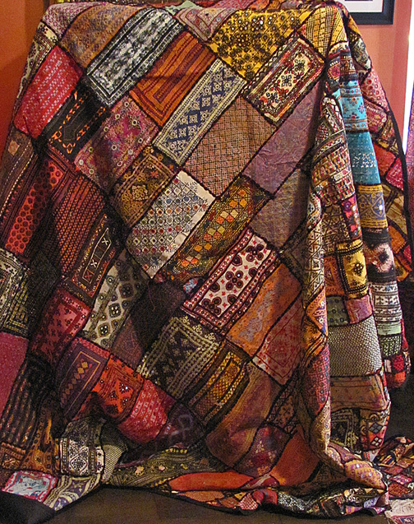

Slide 41
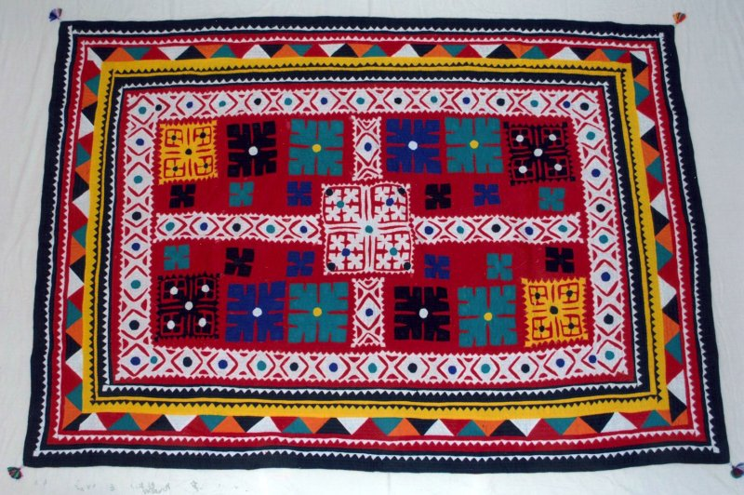
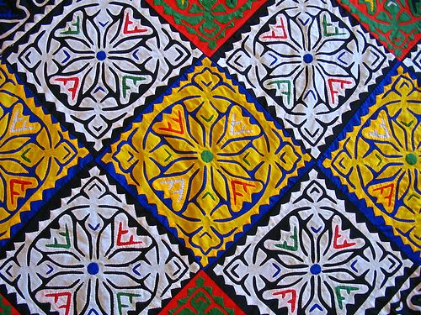

Slide 42
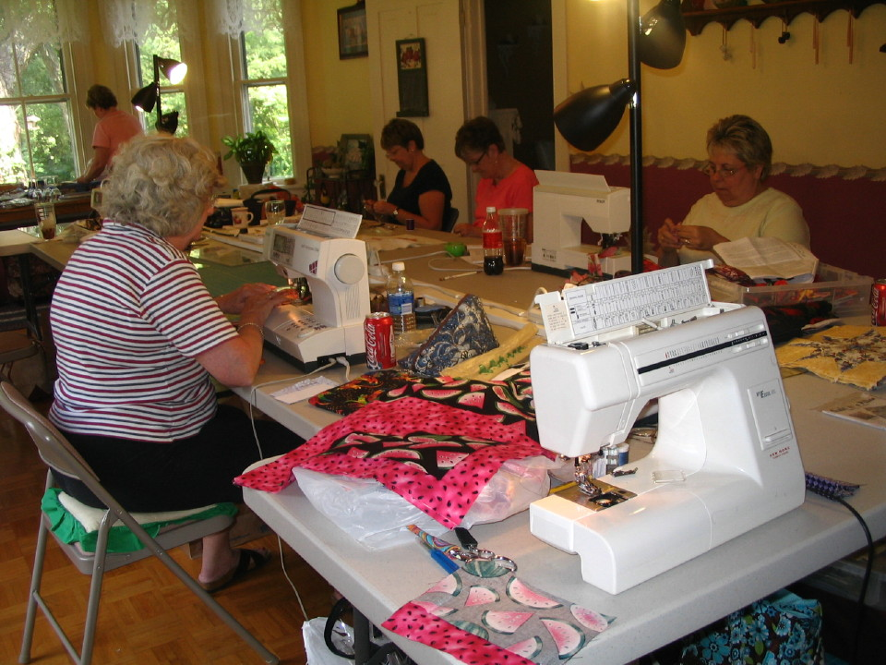
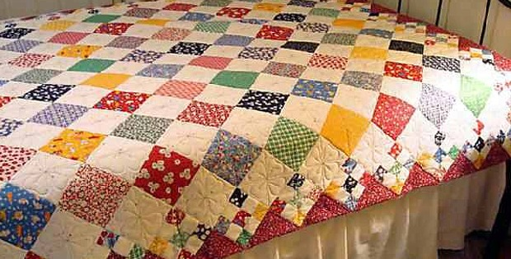

Slide 43
CROCHET
Crochet is a process of creating fabric from yarn, thread, or other material strands using a crochet hook. The word is derived from the French word "crochet", meaning hook.
Hooks can be made of materials such as metals, woods, or plastic and are commercially manufactured as well as produced by artisans.

Slide 44
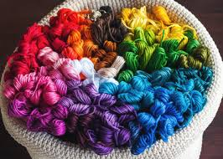
Crocheting, like knitting, consists of pulling loops of material through other loops, but additionally incorporates wrapping the working material around the hook one or more times.

Slide 46
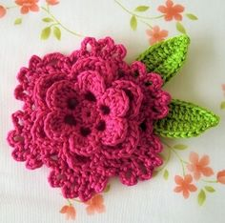
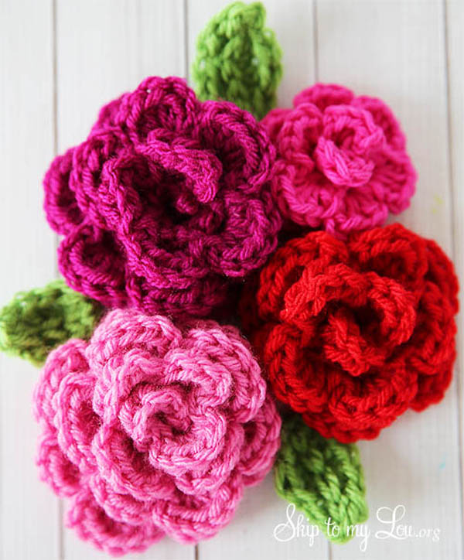

Slide 48
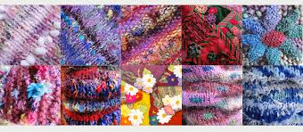
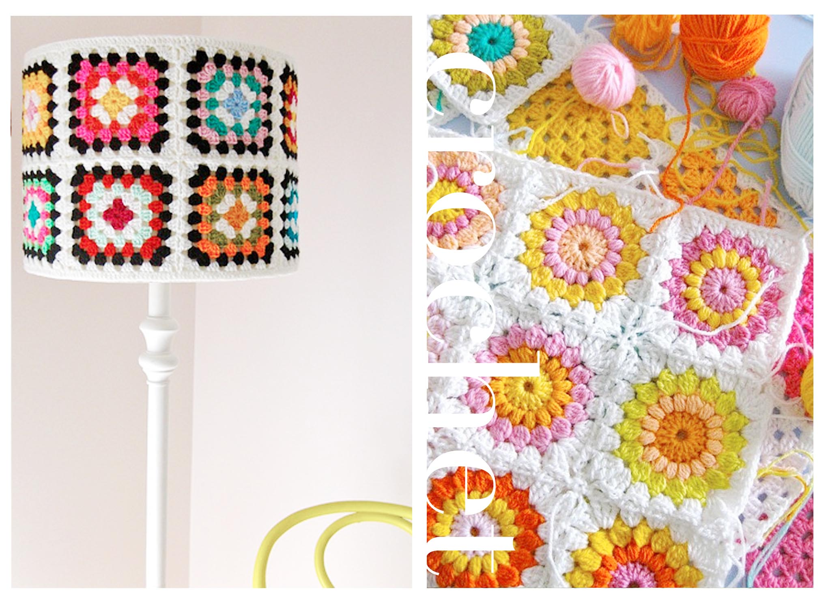

Slide 50
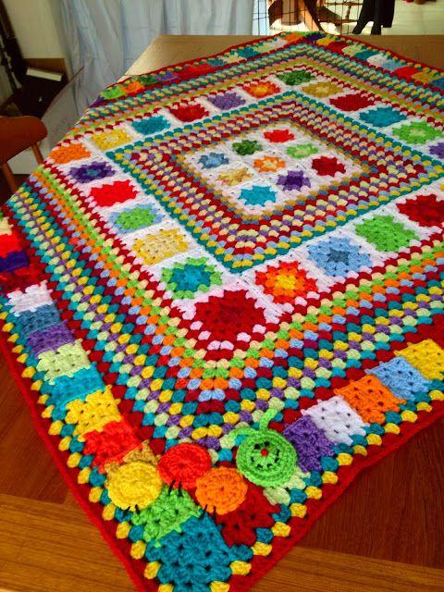

Slide 52
